Slide 1
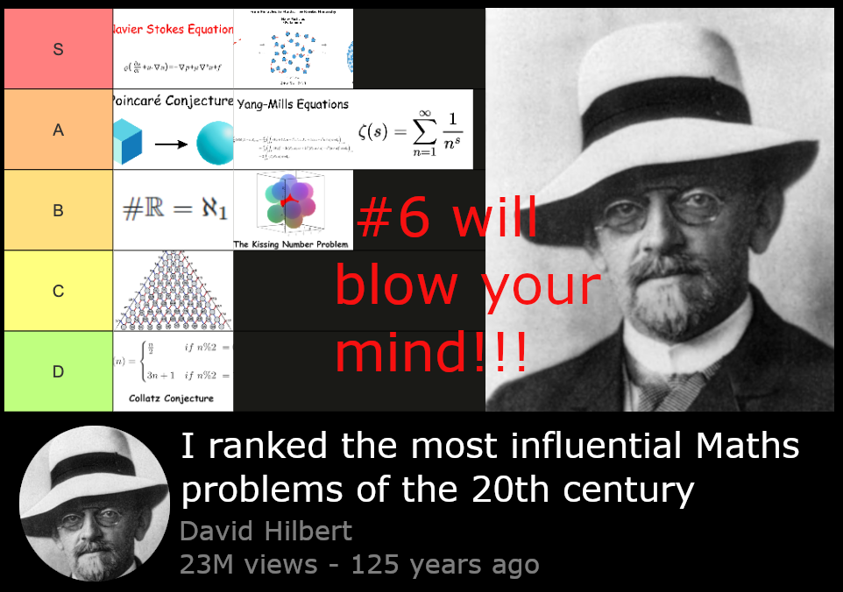
Computational Hybrid Methods for Kinetic Transport
Johannes Krotz
(Aerospace & Mechanical
Engineering)

Slide 2
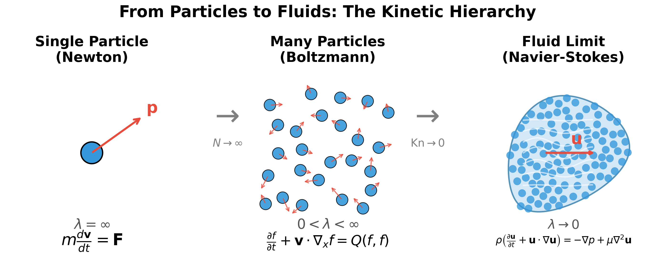
Hilbert’s 6th Problem

Slide 3
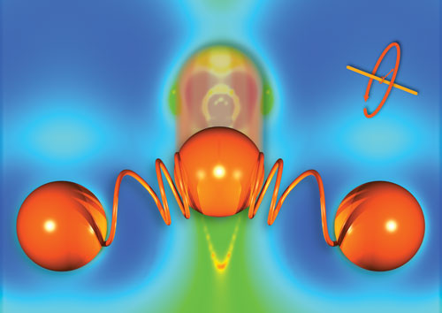

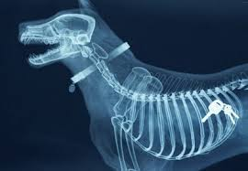
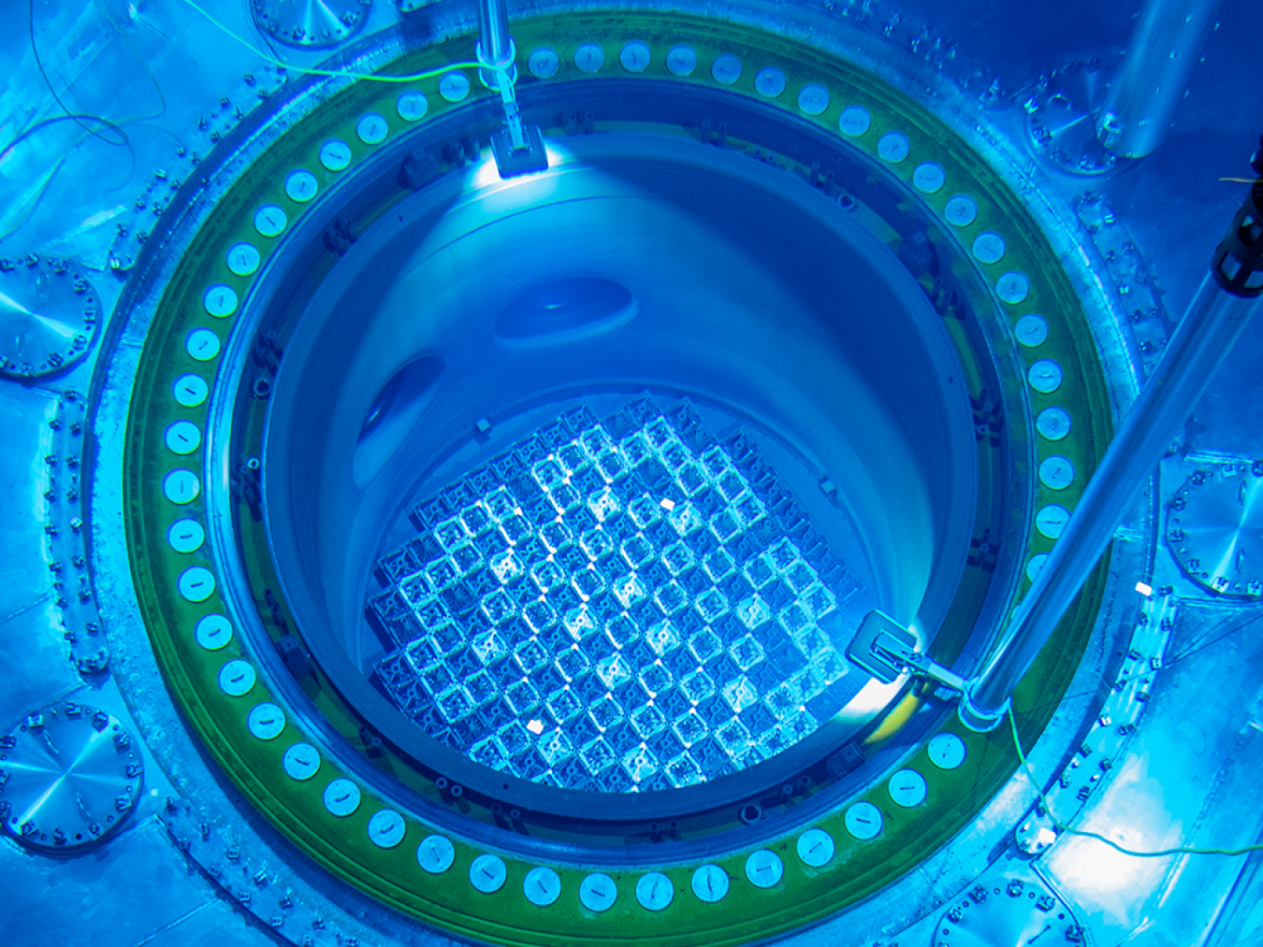


Slide 4
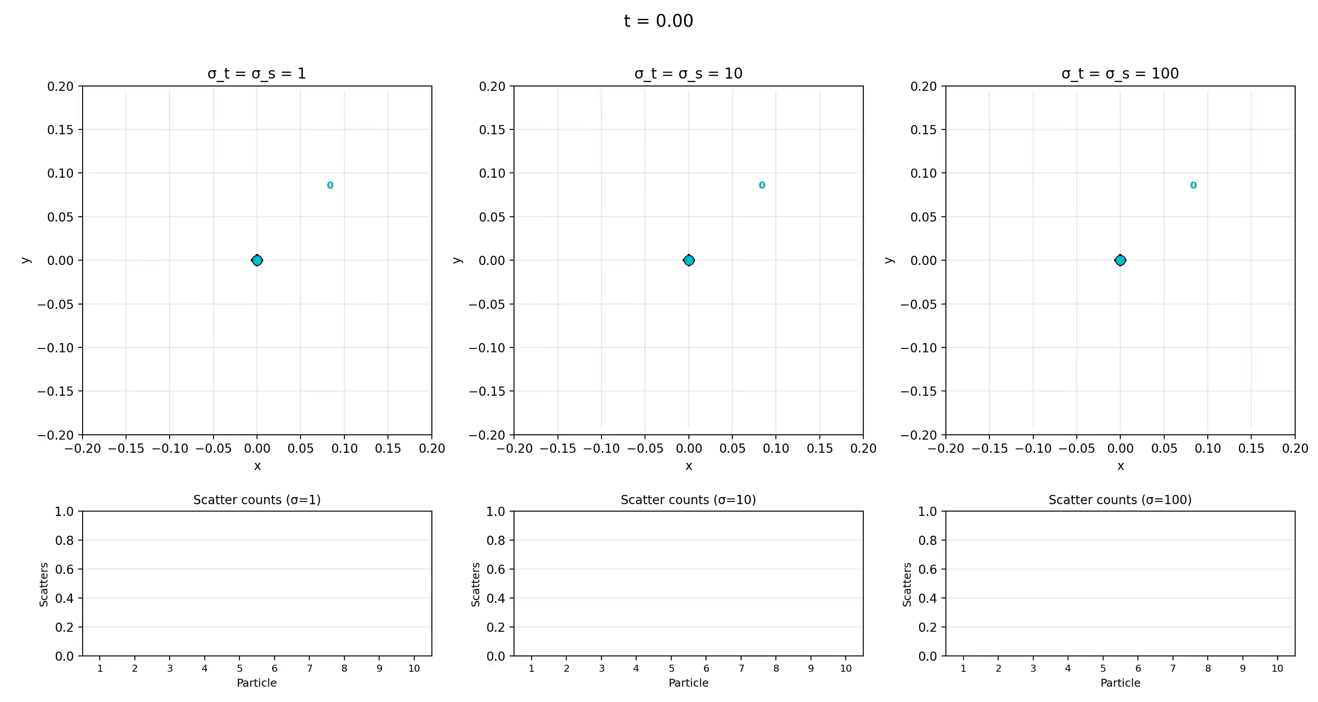
Toy Problem

Slide 5
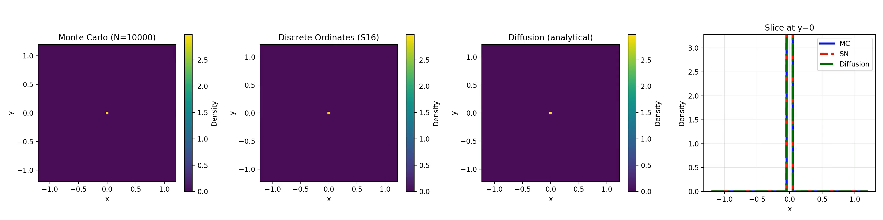


Slide 6
Simulation(MC) vs PDE(deterministic)
MC is cheap and accurate where scattering is low
Slows down with many interactions
Captures wave fronts
Deterministic shines, where scattering is high
Struggles with discontinuities (fronts)

Slide 7
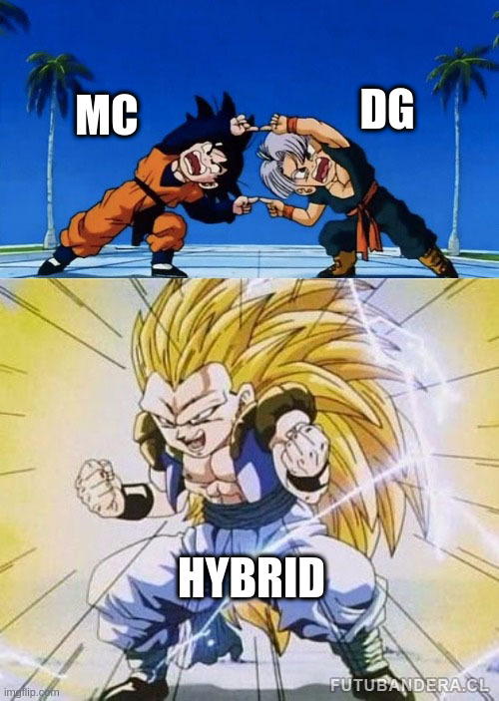
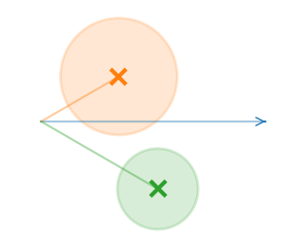
Hybrid
Split particles into collided & uncollided
Simulate uncollided with MC
Solve for collided Densities with PDE

Slide 8



Slide 9
Summary & Future work
MC + PDE patch each other’s weaknesses
Tested on several more realistic Benchmarks
Hybrids are more accurate and/or cheaper, often both
Expand: Multiscatter/Multienergy, Nonisotropic and Nonlinear
Apply: Phonon/Reactor

Slide 10
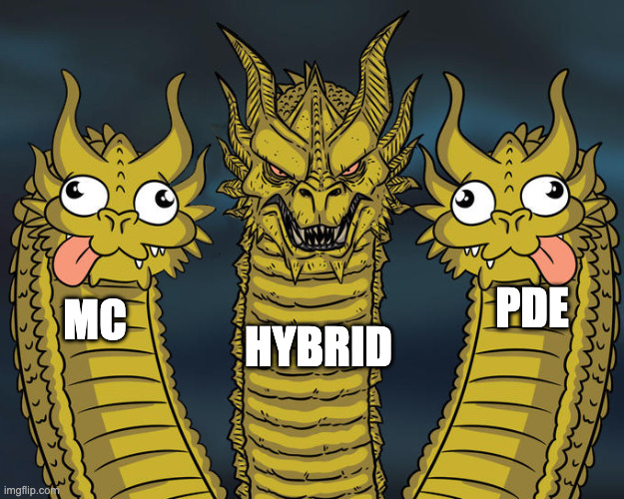
Questions?

